Slide 1
SWIGGY DATA ANALYSIS
by Abdul Raffay Naeem

Slide 2
Project Overview
In today's competitive landscape, Swiggy, a prominent online food ordering and delivery platform, relies heavily on data driven insights to maintain its market position and drive growth. The analysis of Swiggy's comprehensive dataset, which includes information on users, restaurants, food items, menus, orders, delivery partners, and order details, is crucial for deriving meaningful business insights.
These insights help Swiggy enhance customer satisfaction, optimize operational efficiency, manage restaurant and delivery partner performance, and develop strategic initiatives for market expansion and revenue growth. By leveraging data effectively, Swiggy can make informed decisions that contribute to its success and sustainability in the food delivery industry.

Slide 3
1
User Inactivity
Find customers who have never ordered

Slide 4
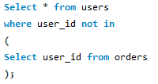

Query
Result

Slide 5
INSIGHTS
By analyzing this, Swiggy can take targeted actions to enhance user engagement, improve customer experience, and ultimately increase the number of active customers on its platform.

Slide 6
2
Pricing Strategy
Find average price across all dishes

Slide 7
Query
Result

Slide 8
INSIGHTS
By understanding the average price across all dishes, Swiggy can evaluate its overall pricing strategy. This information helps in setting competitive prices that attract customers while ensuring profitability.

Slide 9
3
Restaurant Popularity
Find the top restaurant in terms of the number of orders for a given month (June)

Slide 10
Query
Result

Slide 11
INSIGHTS
Identifying the top restaurant based on the number of orders in a given month helps Swiggy understand which restaurants are most popular among customers. This information can be used to promote these restaurants further or replicate their successful strategies with other partners.

Slide 12
4
Identifying High Performers
Find restaurants with monthly sales greater than x for
(x = Total Avg sales across all restaurants)

Slide 13
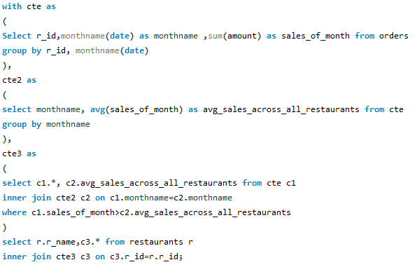
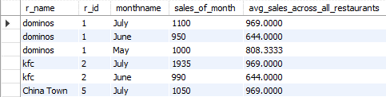
Query
Result

Slide 14
INSIGHTS
This query highlights which restaurants consistently outperform others in terms of sales. Identifying these high-performing restaurants allows Swiggy to understand what makes them successful, such as menu items, pricing strategies, or customer service.

Slide 15
5
Customer Behavior
Find all orders with order details for a particular customer (3) in a particular date range (June)

Slide 16

Query
Result

Slide 17
INSIGHTS
Understanding the order patterns of a specific customer within a date range helps Swiggy analyze individual preferences and behavior. This can inform personalized marketing strategies and recommendations.

Slide 18
6
Customer Retention
Find restaurants with max repeated customers

Slide 19
Query
Result

Slide 20
INSIGHTS
The success of this restaurant in retaining customers suggests that it employs effective retention strategies. Understanding these strategies can provide Swiggy with best practices that can be shared with other restaurant partners to improve their retention rates.

Slide 21
7
Revenue Trend
Month over month revenue growth of Swiggy

Slide 22
Query
Result

Slide 23
INSIGHTS
Understanding month-over-month revenue growth helps Swiggy identify trends in its financial performance. It can reveal periods of high growth, stability, or decline, allowing the company to respond proactively to changes.

Slide 24
8
Customer Preferences
Find Customer’s favourite food

Slide 25
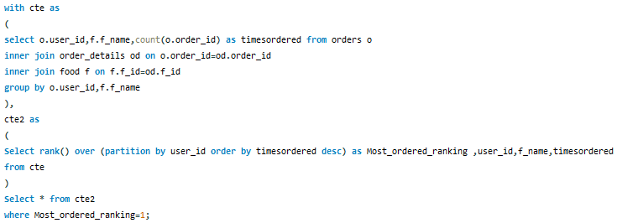
Query

Slide 26
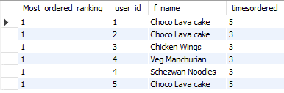
Result

Slide 27
INSIGHTS
By identifying popular food items among customers, Swiggy can guide partner restaurants in optimizing their menus. Restaurants can focus on maintaining the quality and availability of these high-demand items to meet customer expectations.

Slide 28
9
Customer Loyalty
Find the most loyal customers for all restaurant

Slide 29
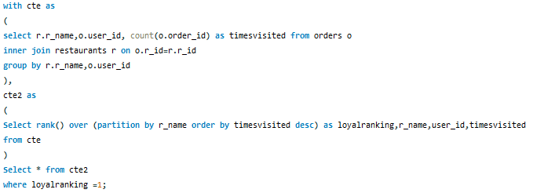
Query

Slide 30
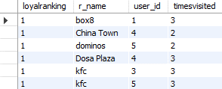
Result

Slide 31
INSIGHTS
Identifying the most loyal customers for each restaurant helps Swiggy recognize where customer loyalty is strongest. These customers are likely to provide consistent revenue and positive word-of-mouth referrals.

Slide 32
10
Revenue Trend
Month-over-month revenue growth of a restaurant (2=KFC)

Slide 33
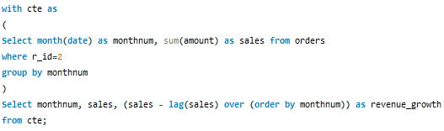

Query
Result

Slide 34
INSIGHTS
Understanding month-over-month revenue growth helps identify trends in the restaurant's financial performance. It can reveal periods of high growth, stability, or decline, allowing Swiggy and the restaurant to respond proactively to changes.

Slide 35
THANK
YOU

